Slide 1

AUGUST GENERAL MEETING August 27, 2020
GENERAL MEETING
Institute of Electrical and Electronic Engineers
Oklahoma State University

Slide 2
AGENDA
Welcome!
Introduce Current Officers
What is IEEE?
Plans for the Semester
Checking-In to This Event
Q&A/Suggestions

Slide 3
CURRENT OFFICERS
Garrett Woodbridge
President
Julia VanHoose
Vice-President
Logan Downs
Secretary
Ryan Horton
Treasurer
Jackson Ball
CEAT Representative
Max Jackman
Publicity Director
Dr. Daqing Piao
Faculty Advisor

Slide 4
WHAT IS IEEE?
IEEE stands for The Institute of Electrical and Electronics Engineers. IEEE is the world’s largest technical professional organization dedicated to advancing technology for the benefit of humanity.
As a student branch of IEEE, our mission is to prepare students for careers in technology.
We do this through various events and projects including company spotlights, social events, and technical workshops.

Slide 5
PLANS FOR THE SEMESTER – WEBSITE & ELECTRONS
We are introducing a new website this year! This website will serve as a place for students and members to stay up to date with everything IEEE.
Check it out at okstateieee.org
We are also introducing a point system. For every event or meeting you attend, you’ll get Electrons. The more Electrons you get, the more entries you get in our end of the semester raffle. All event attendance will be tracked with our website.

Slide 6
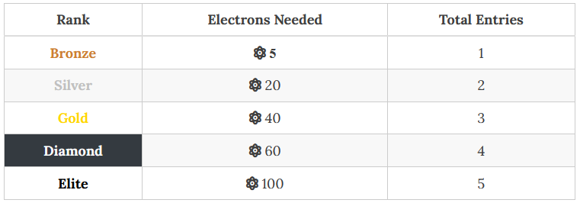
PLANS FOR THE SEMESTER – WEBSITE & ELECTRONS
Want a guaranteed entry? Sign up for a National IEEE Membership ($32) for 5 Electrons!

Slide 7
PLANS FOR THE SEMESTER – COMPANY CONNECTION
Later this semester, we are hoping to introduce a way for you to interact with potential employers and companies.
You will need to have an account on our website to use this feature.
Companies will also be able to view your profile and resume.

Slide 8
PLANS FOR THE SEMESTER – SOFTWARE
We would like to compete in the IEEEXtreme programming competition this year.
It is all virtual.
A max of 3 members per team.
All team members must be paid National IEEE members ($32).
The competition is October 24th.

Slide 9
PLANS FOR THE SEMESTER – HARDWARE
We are planning on offering some circuit kits that you can build at home.
The first kit is a DIY Arduino.
This will most likely require soldering. You can use the soldering stations at the Endeavor after gaining your certification.
We may be able to provide soldering irons and multimeters to check out.

Slide 10
CHECKING-IN TO THIS EVENT
Today’s event is worth 1 Electron!
To check-in, first create an account at our website at okstateieee.org.
After creating an account and signing in, go to checkin.okstateieee.org and clicking “Event Check-In”.

Slide 11

OUR NEXT EVENTS
September 3rd – Texas Instruments Info Session (10 Electrons)
Currently scheduled for 5:30PM
September 9th – Movie Night on Discord (1 Electron)
7:00 PM

Slide 12
FOLLOW IEEE
Website
okstateieee.org
Facebook, Twitter
@osuieee
Discord
discord.okstateieee.org
CampusLink
campuslink.okstate.edu, keyword “IEEE”

Slide 13
Q&A/SUGGESTIONS
Any questions?

